Slide 1
Value of OHN-related services
Thursday, June 03, 2021

Slide 2
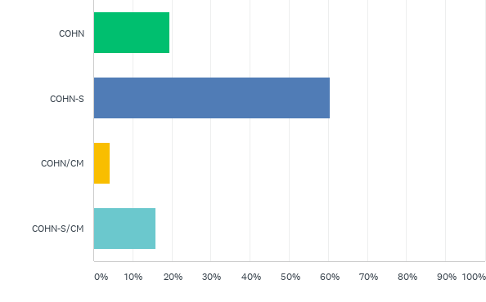
Q1: Which ABOHN certification(s) do you hold?
Answered: 164 Skipped: 0

Slide 3
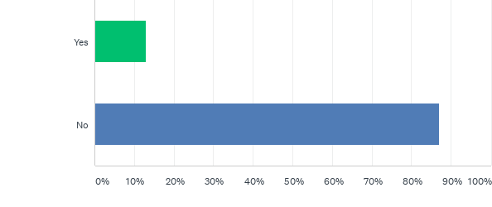
Q2: Are you a Nurse Practitioner?
Answered: 163 Skipped: 1

Slide 4
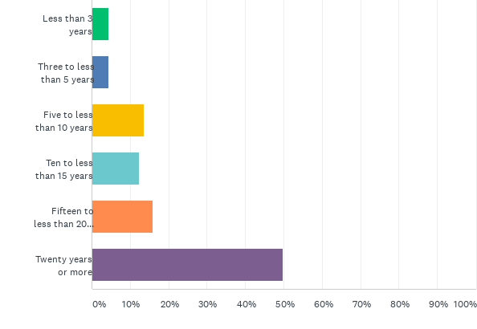
Q3: How many years have you been an OHN?
Answered: 163 Skipped: 1

Slide 5
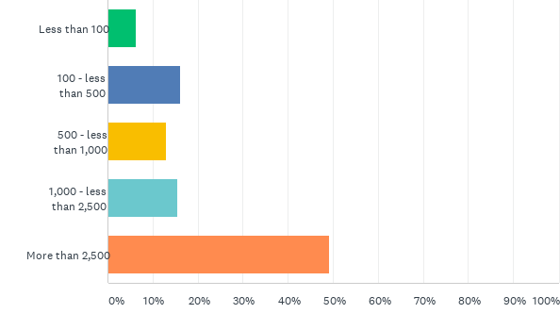
Q4: How many workers are at your place of employment?
Answered: 161 Skipped: 3

Slide 6
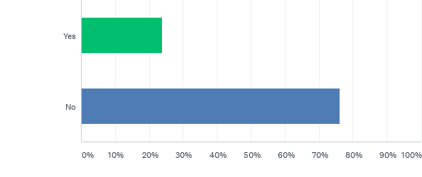
Q5: Do you use a tool or process to gather data and measure the value (cost avoided/ROI) of OHN related services provided at your place of employment?
Answered: 160 Skipped: 4

Slide 7
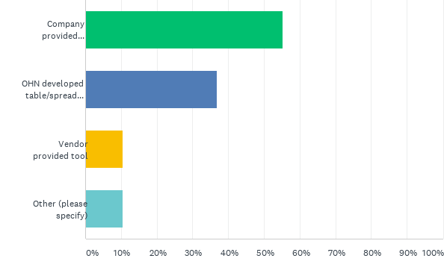
Q6: What type of tool or process did you use for the measurement? Check all that apply
Answered: 38 Skipped: 126

Slide 8
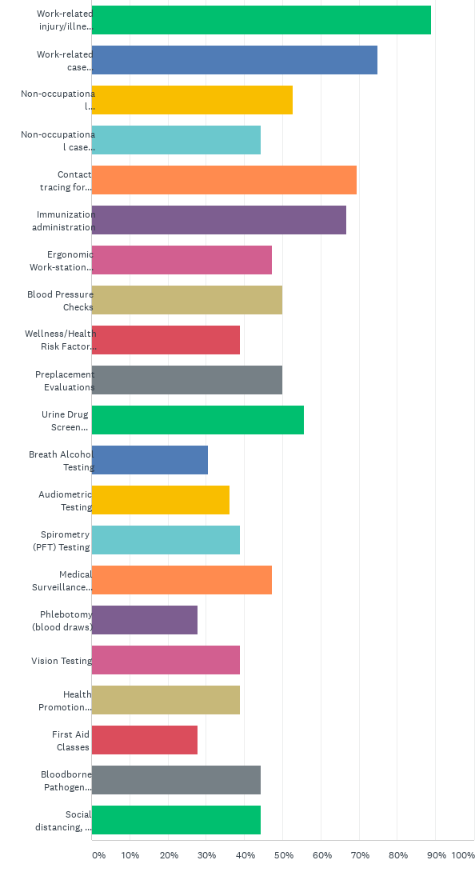
Q7: What types of OHN services do you measure? Check all that apply:
Answered: 36 Skipped: 128

Slide 9
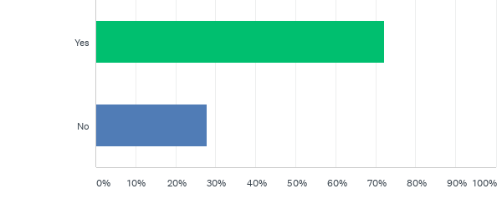
Q8: Were you able to measure or have access to data on indemnity costs avoided due to early return to work and/or accommodating restrictions?
Answered: 36 Skipped: 128

Slide 10
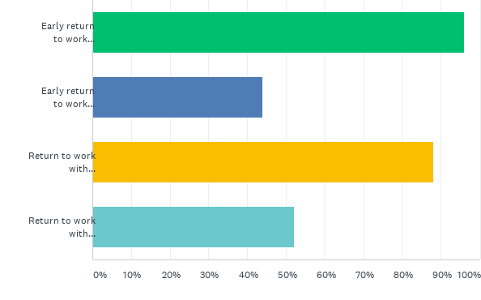
Q9: If yes, check all that apply:
Answered: 25 Skipped: 139

Slide 11
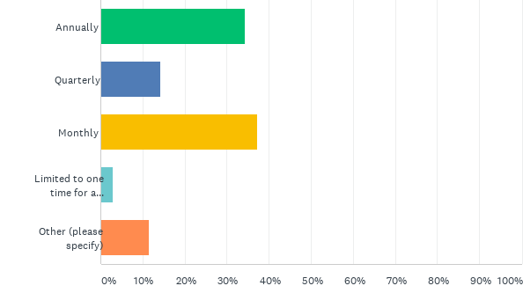
Q10: How frequently did you measure and report the value of the OHN-related services?
Answered: 35 Skipped: 129

Slide 12
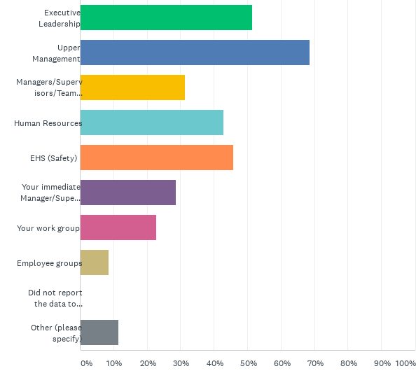
Q11: Who did you report the data to? Check all that apply
Answered: 35 Skipped: 129

Slide 13
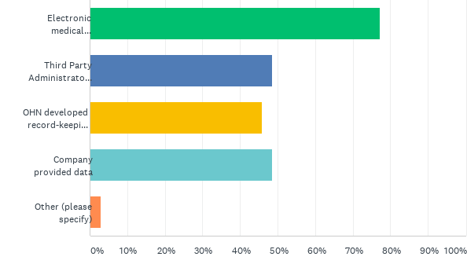
Q12: What are your sources of data? Check all that apply
Answered: 35 Skipped: 129

Slide 14
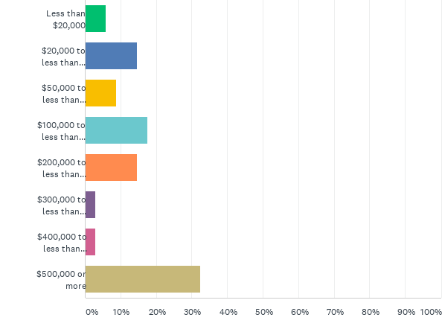
Q13: Please estimate the annual cost avoided/ROI for OHN-related services per full-time OHN:
Answered: 34 Skipped: 130

